Slide 1
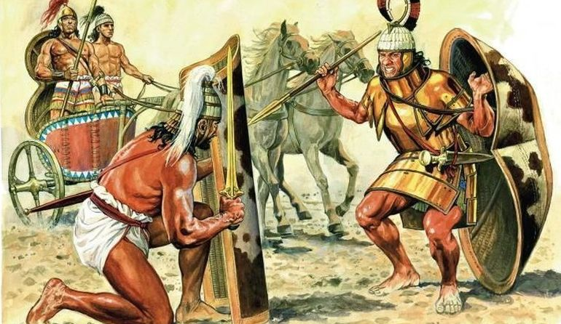
The Myceneans
Goal/s:
describe the Mycenean social and economic structures
Week 8 Lesson 1
Ms Barrie

Slide 2

By the 16th Century BCE, Mycenae was the important of the Greek states.
Wealth came from overseas trade and warrior raids. Kings lived within massively walled fortresses.
Our knowledge of the royal lifestyles and events are from archaeological findings. The Mycenaeans dominated trade in the eastern Mediterranean until the 12th century BCE when Mycenean power was destroyed.
Notes:
Discussion Question – What is similar to the Minoans? What is different to the Minoans?

Slide 3
The Mycenaean Age
The Mycenaean Age was the age of the legendary heroes and of the development of the Mycenaean civilization.
Blend of Minoan and Mycenae traditions
BUT different race to Minoans – taller kings, wore beards, graves with war scenes, not bulls

Slide 5
Geography and resources
fertile plains and raw materials
Crops and livestock (e.g. wheat, goats, grapes)
strategically located in central position

Slide 6
Social Structure
Palace Administration:
The King had his own temenos or land reservation and this was farmed for his direct use. The palace controlled most parts of everyday life.
King’s Nobles:
Small towns and villages were scattered over the countryside, dominated by the King’s nobles and officials.

Slide 7
ACTIVITY 1 – Social Structure
Cut out and organize the cards of the social structure of the Minoans
THEY ARE NOT ALREADY IN ORDER
Before you glue them in your book, make sure you wait to go through the answers

Slide 8
Role and Status of Women
Aristocratic women held some element of independence
Royal and slave women had similar tasks
Domestic chores (managing a household)

Slide 9
ACTIVITY 2 – Mycenaean Economy
Read through the information sheet and answer the following questions:
Describe Mycenean agriculture and industry
include the following words in your answer: self-supporting, trade, pottery
Explain the significance of Palaces to the Mycenaeans
include the following words in your answer: fortification, economic/wealth
Identify TWO (2) items the Mycenaeans EXPORTED, and TWO (2) places they traded with
Explain ONE (1) technological development of the Myceneans

